Slide 1
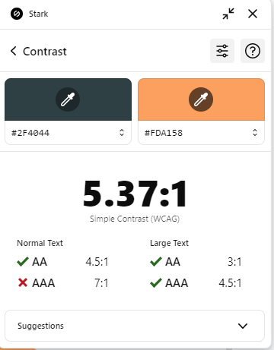




ASP.NET MVC
Part 1
Session 1

Slide 2


Table of contents
01
02
03
Web Apps
MVC Design Pattern
URL Mapping
Web Apps Hosting ,History and Development
MVC stands for..........
Routing
04
05
06
Project Overview
Pass Data To View
State Mangement
create new project. project strurcture ,models and controller
Model, ViewData, ViewBag
ViewMode
store the state somewhere because HTTP protocol is stateless.

Slide 3

Web Apps!
Know difference between web app and desktop app?!

Slide 4
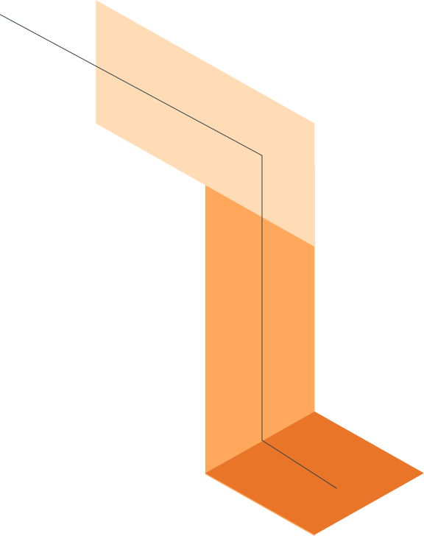
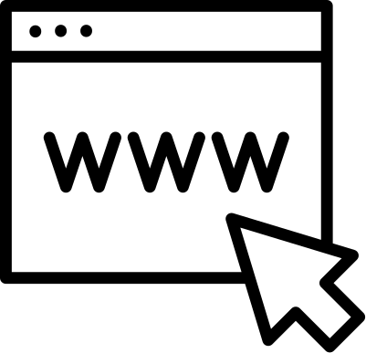
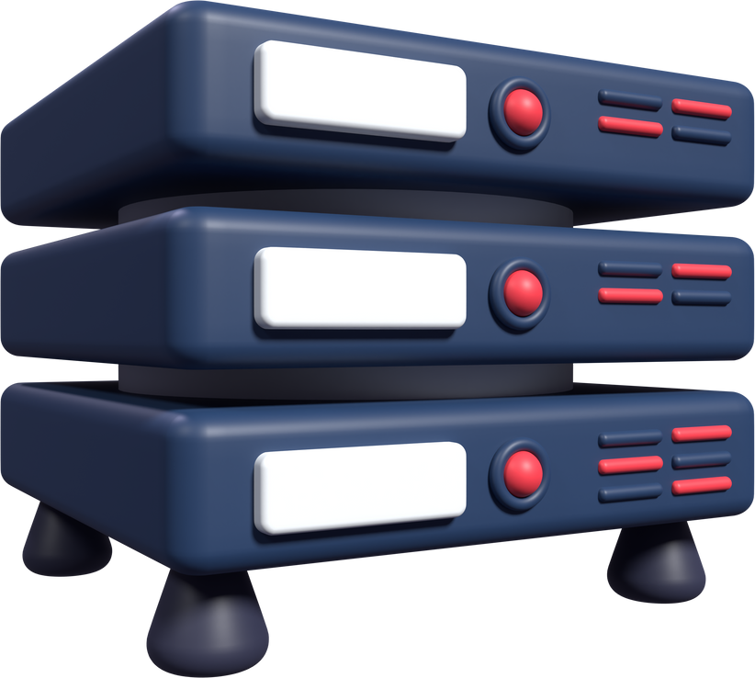
prefer Web Apps or Desktop Apps?
Web Apps
Desktop Apps
Run in the browser
Accessible over the internet
Hosted on a server
It changes frequently without our intervention.
run directly on the operating system
installed locally
often faster.
but what about if i have new version
Notes:
server os:
IIS:Windows
Apache

Slide 5
History of Web Apps

Slide 6

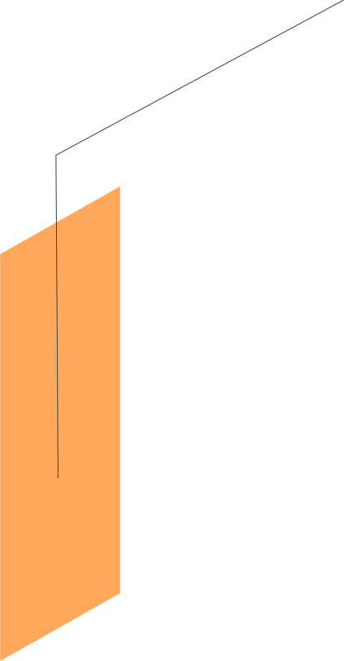
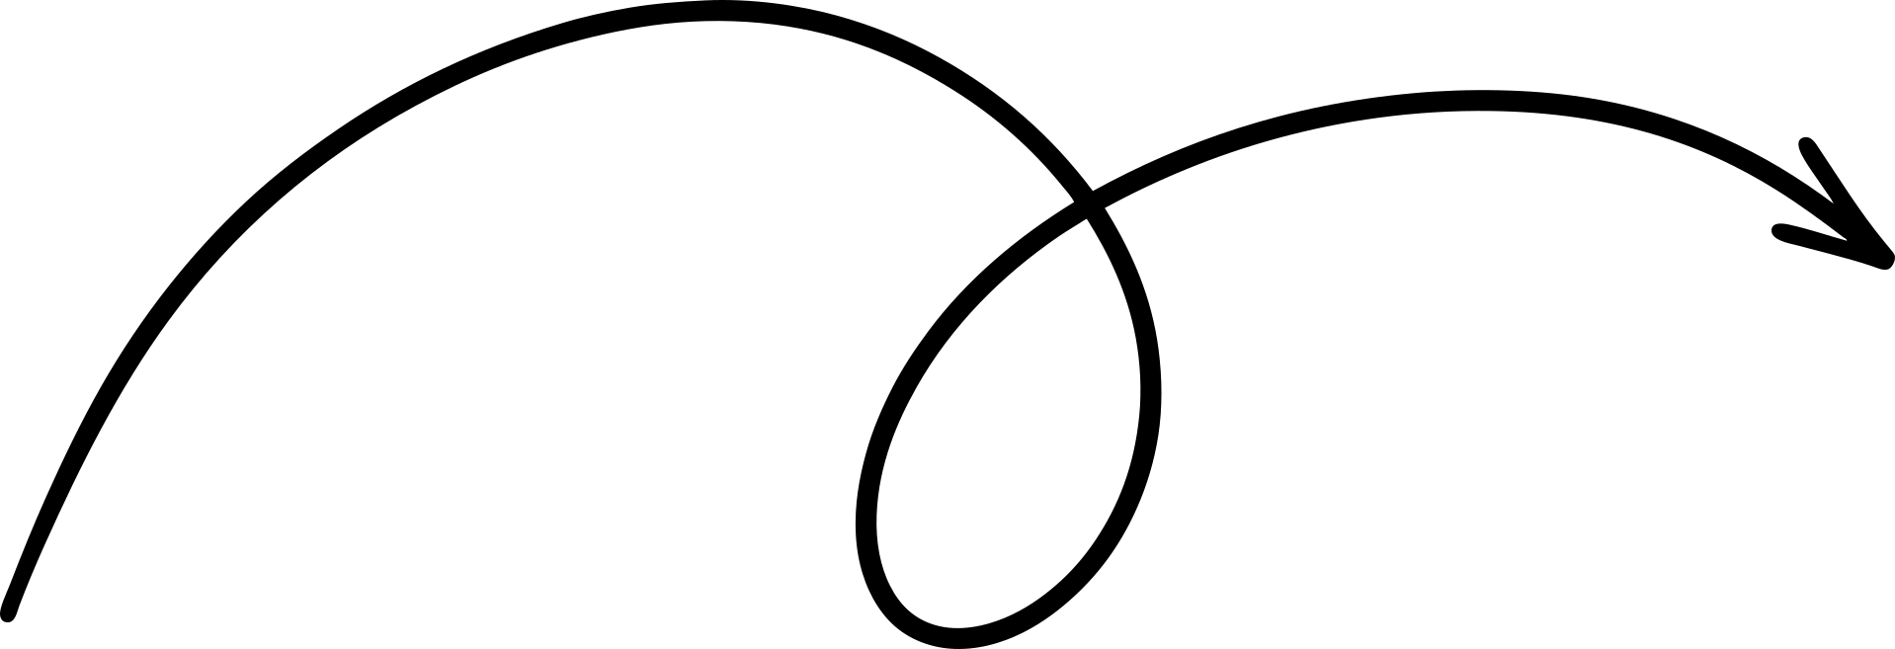
3-2000s: :
MVC frameworks, AJAX.
1-Early 90s:
HTML+CSS= static HTML pages
2-Late 90s:
HTML+CSS+JS= dynamic content
4-Now: APIs + Frontend frameworks.

Slide 7

Development Types?!
Full Website
Web Forms
OR
Backend + Frontend
2.MVC
3-Razor Page
Angular
React
HTML
Windows form
Mobile app
Web API

Slide 8
MVC Design Pattern
Firstly, do you know the features of .NET Core?!
Notes:
1-open source
2-cross plateform

Slide 9


What is Design Pattern?
MVC:
M :Model
V :View
represents the data.
Bussiness Logic
Implement DRY
displays the UI.
Presentation Layer
C :Controller
handles user input and interaction.
Catch Request
Call medol method
Send data to view
Send response
Notes:
Problems before MVC
1-everything in the same file
(UI, accessing Database).interdependencies
MVC features:
1-separate of concern
2-Url Mapping

Slide 10




Request
(C# classes)
Client
Controller
(Browser)
Entity Classes
Database
Response
ASP Pages
View
Model

Slide 11
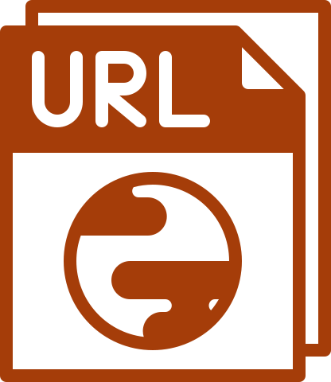
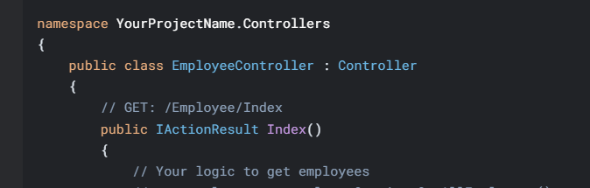
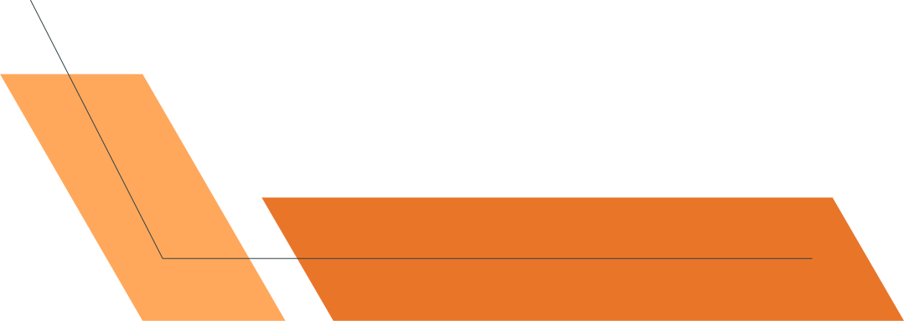
URL Mapping
URL==>Domain/Controller Class/Method Calling
Maps URL to a specific controller and action.
Example: /Employee/Index
What's the benefit?🤔
Increase our website SEO ranking
(Cleaner)
Notes:
Search for Restful

Slide 12
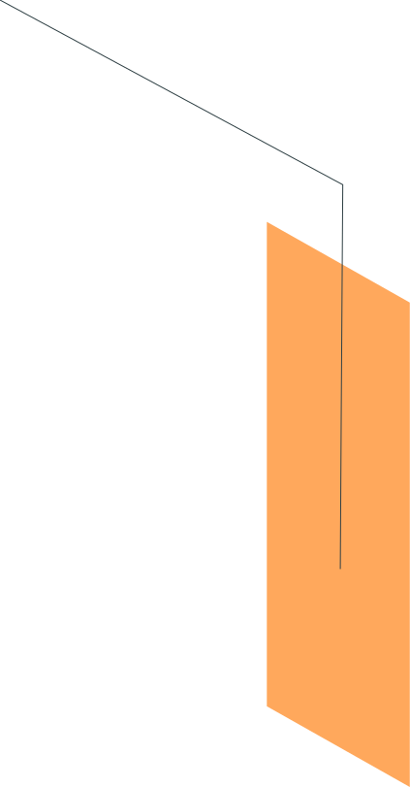
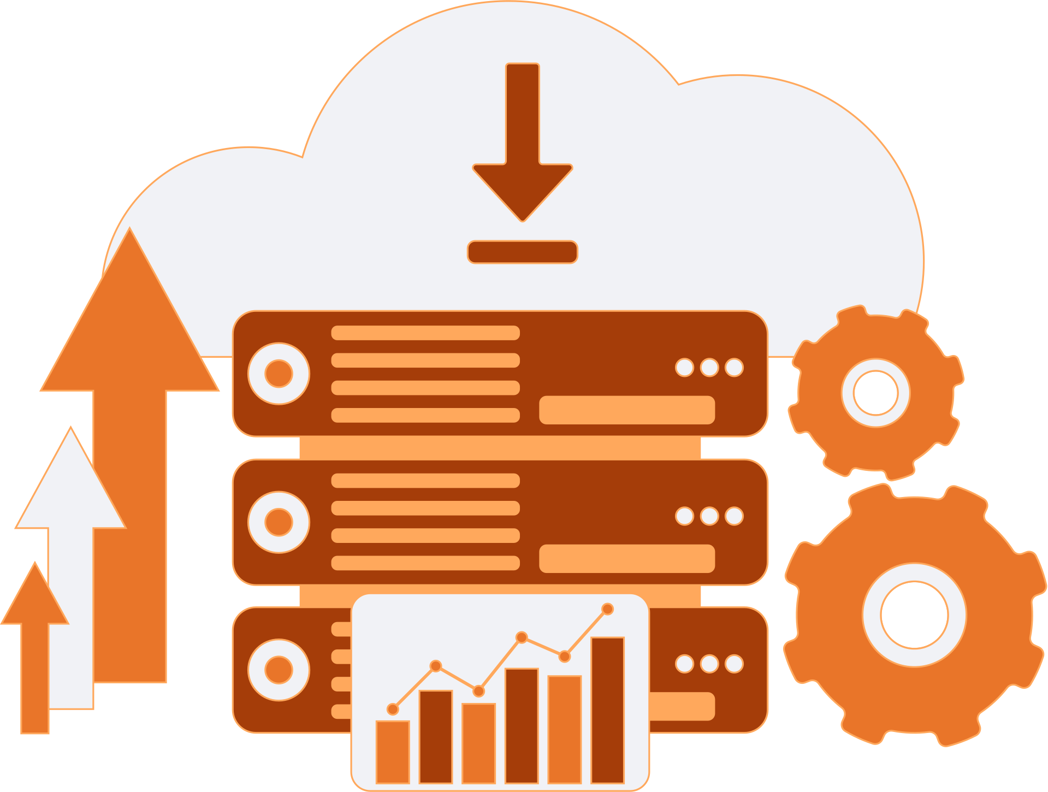
Virtual Hosting vs Self-Hosting
Hosted on IIS Express.
Use Kestrel directly to run app.

Slide 13
Project Structure

Slide 14

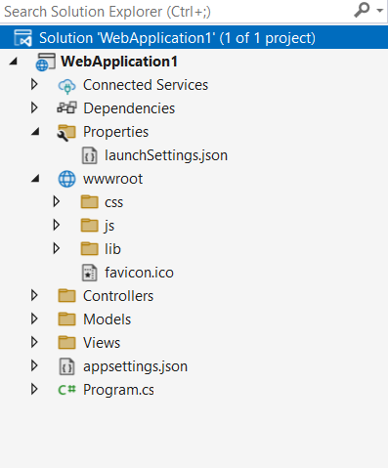
wwwroot: contains static files
Configuration Files
appsettings.json
Configuration settings for the application
Program.cs
Entry point of the application
Configures services and the HTTP request pipeline
Properties/launchSettings.json
Configuration for how the application launches

Slide 15

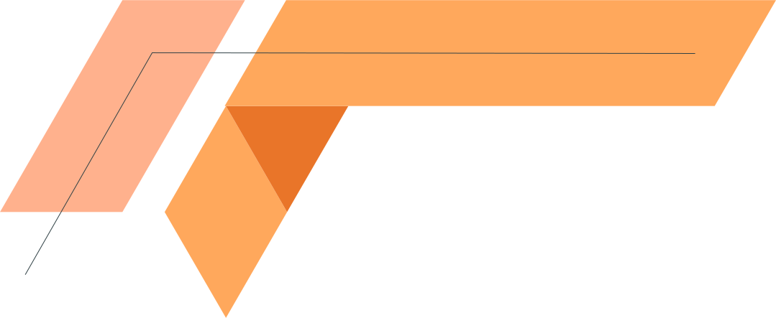
MODEL
Notes:
public ProductData() {
products = new List<Product>();
products.Add(new Product() { Id = 1, Name = "Mug", Category = "Cups",Image= "1.jpeg" });
products.Add(new Product() { Id = 2, Name = "Glass", Category = "Cups", Image = "1.jpeg" });
products.Add(new Product() { Id = 3, Name = "bowl", Category = "Cups", Image = "1.jpeg" });
}
HTML code
<div class="card" style="width:400px">
<img class="card-img-top" src="../bootstrap4/img_avatar1.png" alt="Card image" style="width:100%">
<div class="card-body">
<h4 class="card-title">John Doe</h4>
<p class="card-text">Some example text some example text. John Doe is an architect and engineer</p>
<a href="#" class="btn btn-primary">See Profile</a>
</div>
</div>

Slide 16
MODEL
It’s a class with a .cs (for C#) extension that defines the Properties and behaviors of the data entities in your application.
The Model communicates directly with the Database to fetch, insert, update, or delete information. This separation keeps the data layer distinct from how the information is displayed or interacted with.
The Model is responsible for enforcing data validation

Slide 17
CONTROLLER

Slide 18
CONTROLLER
•The Controller in MVC architecture handles any incoming URL request.
•Controller class contains public methods called Action methods.
•Controller and its action method handles incoming browser requests, retrieves necessary model data and returns appropriate responses.
•Every controller class name must end with a word "Controller“, Ex: ProductController.
•A controller action returns something called an ActionResult.

Slide 19
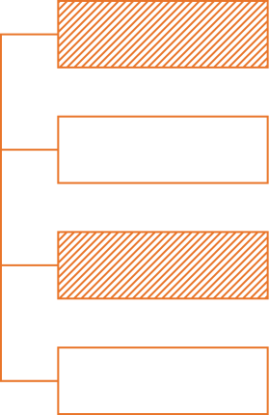
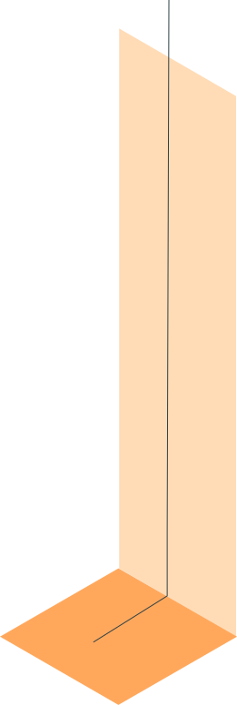
an abstract class. It is a base class for all type of action results.
ACTION RESULT
ViewResult
Represents HTML and markup.
There are different Types of action results in ASP.NET MVC. Each result has a different type of result format to view page
ContentResult
Represents a String literal.
JasonResult
Returns data in JSAN format
RedirectResult
Represents a redirection to a new URL.
and many more

Slide 20
VIEW

Slide 21
VIEW
It receives data from the Controller (which fetches it from the Model) and renders it into a format suitable for the end user, such as HTML pages in a web application.
A view in ASP.NET Core MVC Application is a file with “.cshtml” (for C# language) extension. The meaning of cshtml = CS (C Sharp) + HTML.
Razor Views: These are the most common views in ASP.NET Core MVC. They use the Razor syntax (.cshtml files).
Razor Syntax Rules for C# are given below:
It must be always enclosed in @{ ... }
Variables are declared with var keyword
Inline expressions (variables and functions) start with @

Slide 22

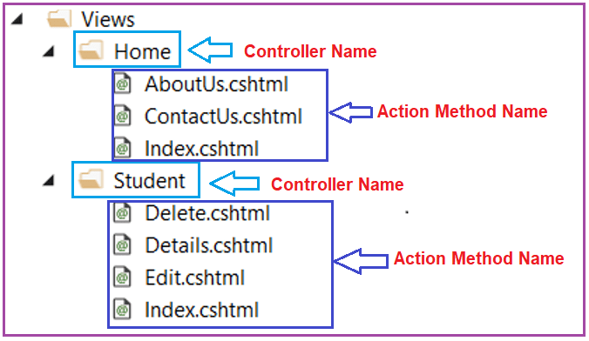
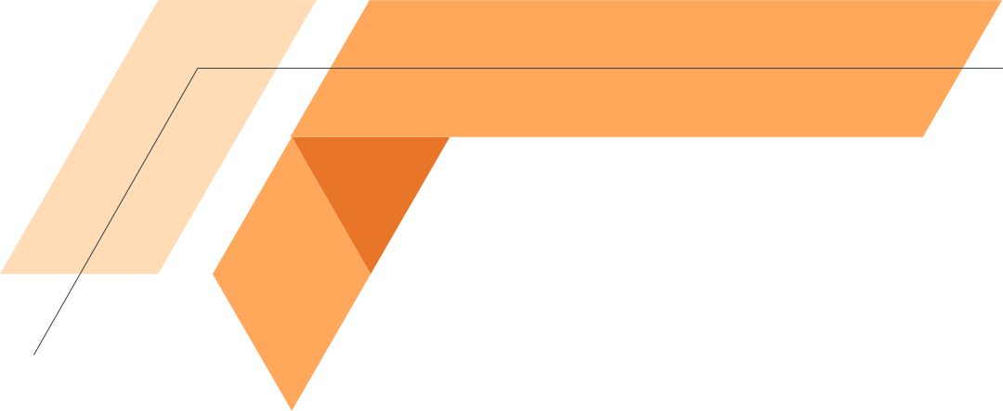
VIEW
a separate folder is created for each controller within the Views Folder.
The Home folder represents the HomeController, and the Student folder represents the Student Controller.

Slide 23
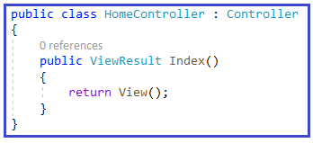
VIEW
If you use the View() or View(object model) extension method to return a view, it will look for the view file with the same name as the action method name. If you want to pass model data, you need to use the overloaded version of the View method,

Slide 24
Strongly Typed View
A Strongly Typed View is a Razor view that is bound to a specific data model (class). This means the view directly knows about the shape and type of data it should expect, allowing for full IntelliSense support, compile-time type checking, and easy access to model properties
Inside the view, you can directly access the properties of the model using Razor syntax (@Model.PropertyName).
@model FirstCoreMVCApplication.Models.Student

Slide 25
Hands on!
Ready?!
Create a new ASP.NET MVC Project Name: "SessionDemo"
Add a Model (Users.cs) properties(user-name,Id)
Create a Controller (SessionController.cs) with action index
Add a View (View1.cshtml)(With any html code)

Slide 26
Break 🎉🤩

Slide 27
Let’s integrate EF Core

Slide 28
Middlewares and Flow of the Request

Slide 29
ASP.NET Core Middleware Components
They are the basic building blocks of the Request Processing Pipeline in ASP.NET Core Applications.
So, middleware components are used to implement various functionalities like authentication, authorization, error handling, routing, and logging.
Important Characteristics
Order Matters
Termination
Dual Direction
Flexibility

Slide 30
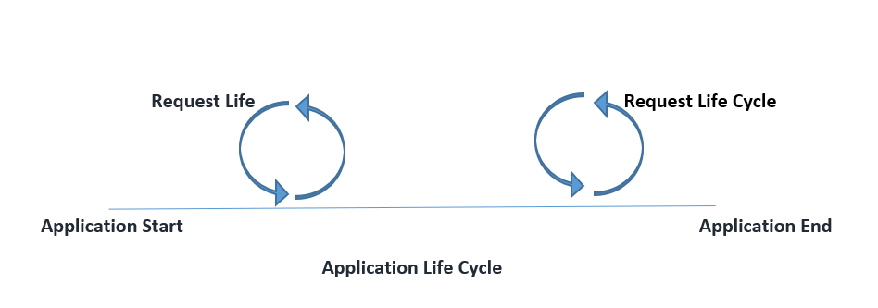
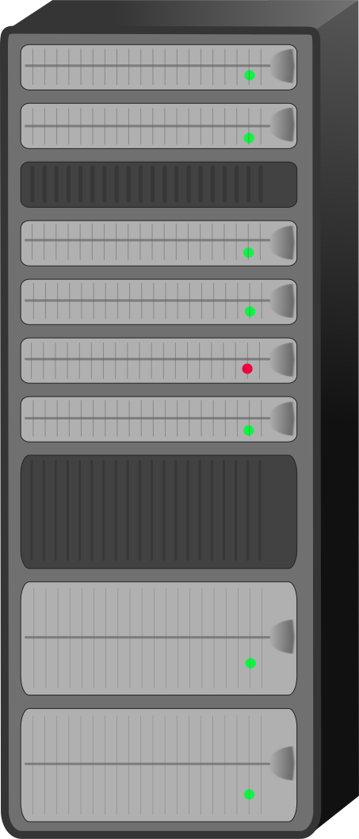

Flow of the Request
Client
storage
kestral
middlewares
logic
IIS

Slide 31
Pass Data To View

Slide 32
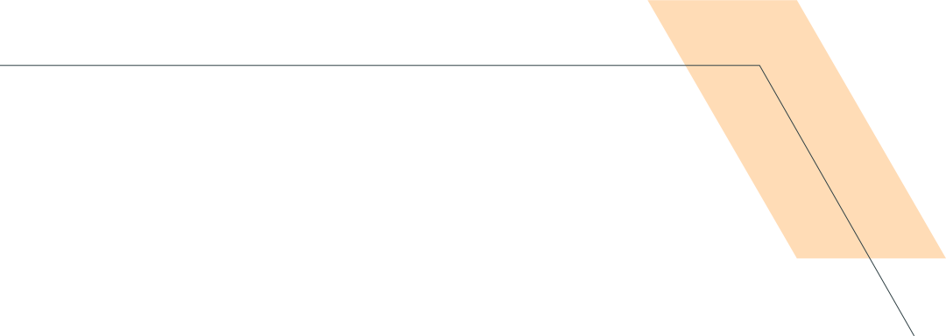
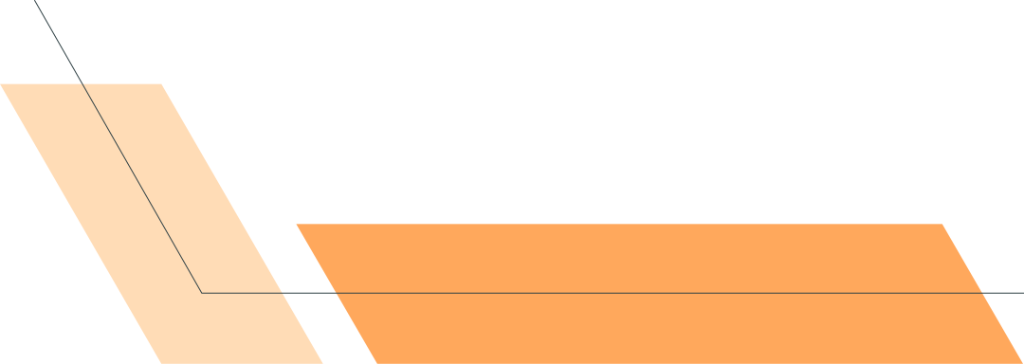
viewData | viewBag
Key-Value Dictionary collection | It is a type object
it is accessible by string as key | is a property of controller that exposes an instance of the ViewDataDictionary class.
The lifespan is only for the current request | The lifespan is only for the current request

Slide 33
State Management

Slide 34
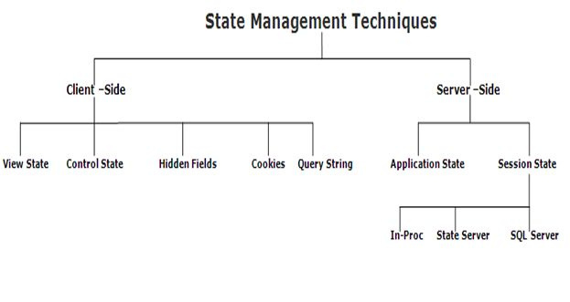
What is State Management
It is the process of synchronizing the state of the application over the mulitple requests for the same or different pages.
in this case HTTP/HTTPs doesn't remember what website or URL we visited, or in other words we can say it doesn't hold the state of a previous website that we visited before closing our browser, that is called stateless.

Slide 35
sessions

Slide 36
Sessions
Purpose:
Stores user-specific data on the server for the duration of a user's session.
Lifespan:
Data persists across multiple requests within a single user's session until the session times out or is explicitly abandoned.
Storage:
Stored on the server. A session ID is typically sent to the client as a cookie to identify the session.

Slide 37
cookies

Slide 38
Cookies
Purpose:
Stores small pieces of data directly on the client's browser.
Lifespan:
Can be either "session cookies" (deleted when the browser closes) or "persistent cookies" (have an expiration date and persist across browser sessions).
Storage:
Stored on the client's machine.

Slide 39
tempdata

Slide 40
Tempdata
Purpose:
Designed for transferring data between a single subsequent request (e.g., from an action method to a view after a redirect).
Lifespan:
Data is available only for the current request and the immediate subsequent request. Once read, it is typically marked for deletion.
Storage:
By default, TempData in ASP.NET Core uses cookies to store its data. It can also be configured to use session state.

Slide 41
Thanks!

Slide 42
Resources
•The Controller in MVC architecture handles any incoming URL request.
•Controller class contains public methods called Action methods.
•Controller and its action method handles incoming browser requests, retrieves necessary model data and returns appropriate responses.
•Every controller class name must end with a word "Controller“, Ex: ProductController.
•A controller action returns something called an ActionResult.

